Slide 1
Osteology of Pelvic girdle, thigh and knee joint.

Slide 2
PELVIC GIRDLE
The pelvic girdle is a ring-like bony structure, located in the lower part of the trunk.
It connects the axial skeleton to the lower limbs.

Slide 3
The strong and rigid pelvis is adapted to serve a number of roles the main functions being:
Transfer of weight from the upper axial skeleton to the lower appendicular components of the skeleton, especially during movement.
Provides attachment for a number of muscles and ligaments used in locomotion.
Contains and protects the abdominopelvic and pelvic viscera.

Slide 4
The pelvic girdle is a ring-like bony structure, located in the lower part of the trunk. It connects the axial skeleton to the lower limbs.
The bony pelvis consists of the two hip bones (also known as innominate or pelvic bones), the sacrum and the coccyx.
There are four articulations within the pelvis:
Sacroiliac joints (x2) – between the ilium of the hip bones, and the sacrum
Sacrococcygeal symphysis – between the sacrum and the coccyx.
Pubic symphysis – between the pubis bodies of the two hip bones.
Ligaments attach the lateral border of the sacrum to various bony landmarks on the bony pelvis to aid stability.

Slide 5
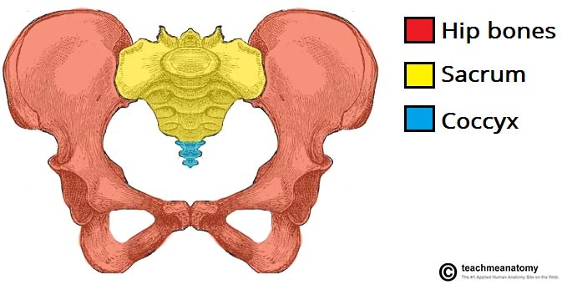

Slide 6
The strong and rigid pelvis is adapted to serve a number of roles in the human body. The main functions being:
Transfer of weight from the upper axial skeleton to the lower appendicular components of the skeleton, especially during movement.
Provides attachment for a number of muscles and ligaments used in locomotion.
Contains and protects the abdominopelvic and pelvic viscera.

Slide 7
The Greater and Lesser Pelvis
The osteology of the pelvic girdle allows the pelvic region to be divided into two:
Greater pelvis (false pelvis) – located superiorly, it provides support of the lower abdominal viscera (such as the ileum and sigmoid colon). It has little obstetric relevance.
Lesser pelvis (true pelvis) – located inferiorly. Within the lesser pelvis reside the pelvic cavity and pelvic viscera.
The junction between the greater and lesser pelvis is known as the pelvic inlet. The outer bony edges of the pelvic inlet are called the pelvic brim.

Slide 8
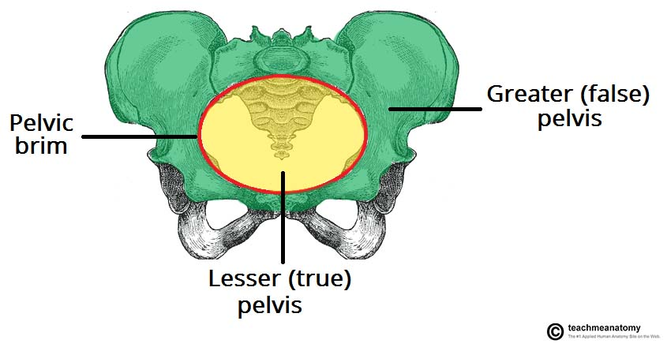

Slide 9
PELVIC INLET
The pelvic inlet marks the boundary between the greater pelvis and lesser pelvis. Its size is defined by its edge, the pelvic brim.
The borders of the pelvic inlet:
Posterior – sacral promontory (the superior portion of the sacrum) and sacral wings (ala).
Lateral – arcuate line on the inner surface of the ilium, and the pectineal line on the superior pubic ramus.
Anterior – pubic symphysis.
The pelvic inlet determines the size and shape of the birth canal, with the prominent ridges a key site for attachment of muscle and ligaments.
Some alternative descriptive terminology can be used in describing the pelvic inlet:
Linea terminalis – the combined pectineal line, arcuate line and sacral promontory.
Iliopectineal line – the combined arcuate and pectineal lines. This represents the lateral border of the pelvic inlet.

Slide 10
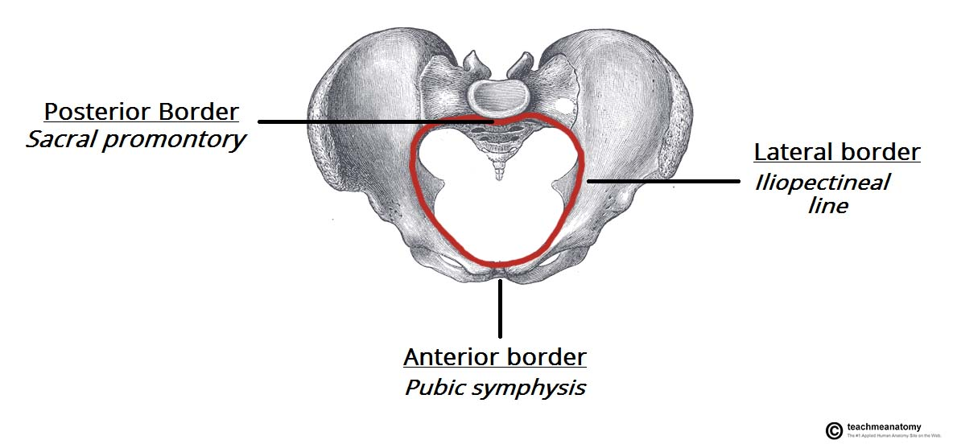

Slide 11
PELVIC OUTLET
The pelvic outlet is located at the end of the lesser pelvis, and the beginning of the pelvic wall.
Its borders are:
Posterior: The tip of the coccyx
Lateral: The ischial tuberosities and the inferior margin of the sacrotuberous ligament
Anterior: The pubic arch (the inferior border of the ischiopubic rami).
The angle beneath the pubic arch is known as the sub-pubic angle and is of a greater size in women.

Slide 12
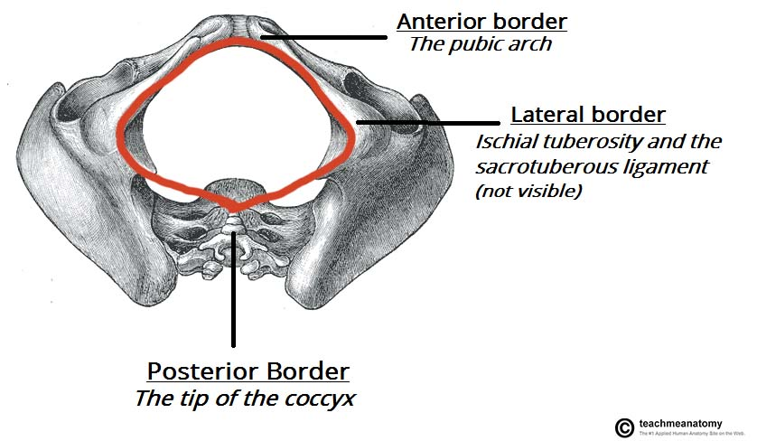

Slide 13
Adaptation for Childbirth
The majority of women have a gynaecoid pelvis, as opposed to the male android pelvis. The slight differences in their structures creates a greater pelvic outlet, adapted to aid the process of childbirth. When comparing the two, the gynaecoid pelvis has:
A wider and broader structure yet it is lighter in weight
An oval-shaped inlet compared with the heart-shaped android pelvis.
Less prominent ischial spines, allowing for a greater bispinous diameter
A greater angled sub-pubic arch, more than 80-90 degrees.
A sacrum which is shorter, more curved and with a less pronounced sacral promontory.
In addition to the bony adaptations, the sacrotuberous and sacrospinous ligaments can stretch under the influence of progesterone and increase the size of the outlet further.

Slide 14
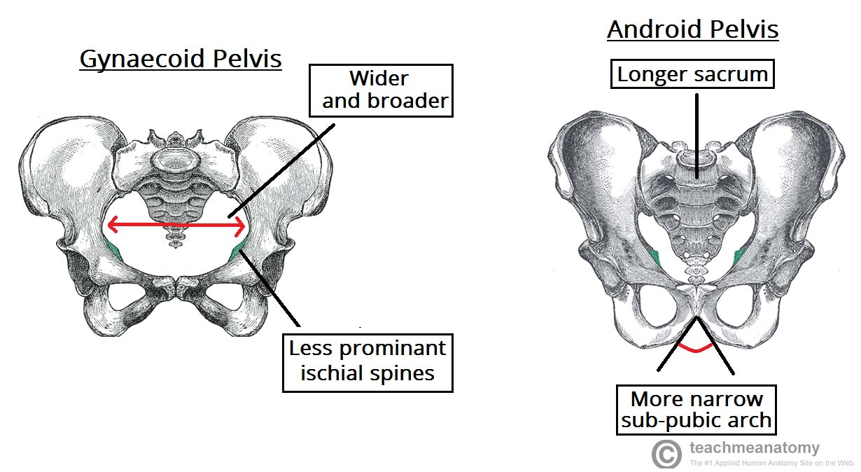

Slide 15
CLINICAL SIGNIFICANCE – ASSESEMENT OF THE FEMALE PELVIS
The lesser pelvis is the bony canal through which the fetus has to pass during childbirth. It is therefore of great importance to determine the diameter of this canal and therefore the childbearing capacity of the mother.
The diameter can be determined by a pelvic examination or radiographically. There are two measurements that are of importance:
Obstetric Conjugate
In order to determine the narrowest fixed distance that the fetus would have to negotiate, the minimum antero-posterior diameter of the pelvic inlet is measured.
This distance is between the sacral promontory and the midpoint of the pubic symphysis (where the pubic bone is thickest) and is known as the obstetric conjugate (or true conjugate). However, this measurement cannot be assessed clinically, due to the presence of the bladder.

Slide 16
Diagonal Conjugate
The diagonal conjugate is the alternative, measuring from the inferior border of the pubic symphysis to the sacral promontory and can be measured manually via the vagina.
(To do this you use the tip of your middle finger to measure the sacral promontory and then using the other hand to mark the level of the inferior margin of the pubic symphysis on the examining hand. You then use the distance between the index finger and the pubic symphysis to measure the diagonal conjugate, ideally 11cm or greater)
In addition to measuring the diagonal conjugate, a mid-pelvis check is carried out. Here, the clinician is testing for straight side walls and measuring the bispinous diameter which is narrowest part of the pelvic canal. The width of the subpubic angle at the pelvic outlet can be determined by the distance between the ischial tuberosities.

Slide 17
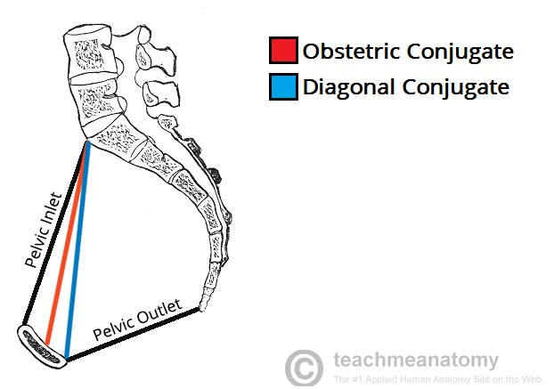

Slide 18
THE HIP
The hip joint is a ball-and-socket synovial joint: the ball is the femoral head, and the socket is the acetabulum.
The hip joint is the articulation of the pelvis with the femur, which connects the axial skeleton with the lower extremity.
The adult os coxae, or hip bone, is formed by the fusion of the ilium, the ischium, and the pubis, which occurs by the end of the teenage years.
The 2 hip bones form the bony pelvis, along with the sacrum and the coccyx, and are united anteriorly by the pubic symphysis.

Slide 19
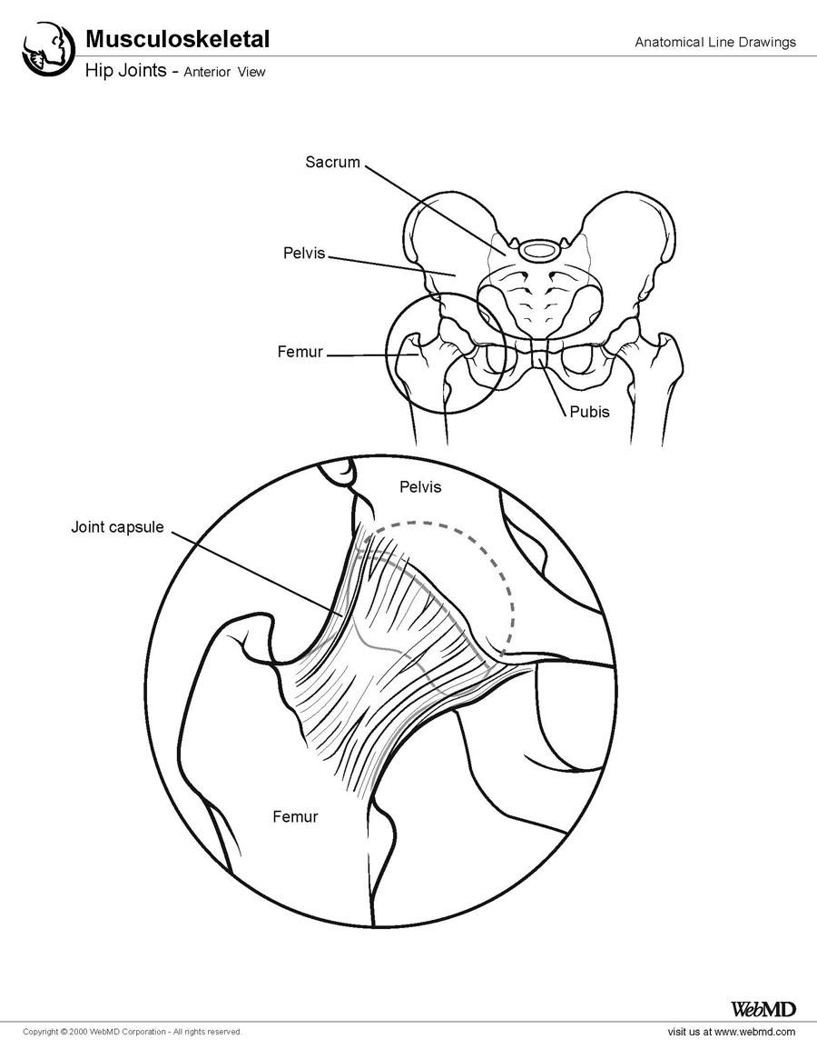

Slide 20
Femur
The femur is the longest and heaviest bone in the human body. It consists of a superior or proximal end, a shaft, and an inferior or distal end

Slide 21
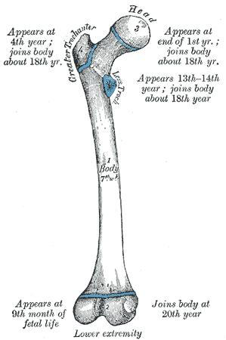

Slide 22
The superior end of the bone is the articulating side of the femur to the acetabulum. The upper femoral epiphysis closes by 16 years of age.
The trabecular bone configuration in the proximal femur obeys Wolff's Law, which states that bony structures orient themselves in form and mass so as to best resist extrinsic forces. The principal compressive group, the principal tensile group, the greater trochanteric group, the secondary tensile group, the secondary compressive group, and, finally, Ward's triangle can be found.
The superior end of the femur consists of a head, a neck, and greater and lesser trochanters. The head of the femur is angled superomedially and slightly anteriorly when articulating with the acetabulum. The head is attached to the femoral body or shaft by the neck of the femur.

Slide 23
The superior border of the neck begins just lateral to the femoral head and ends distally at the greater trochanter. The inferior border of the neck begins lateral to the femoral head and extends to the inferior trochanter. The superior border is shorter and thicker than the inferior border. The anterior surface of the neck is rough in comparison to the smooth femoral head. The neck’s posterior surface has a concave appearance. The head and neck are at an angle of 130º (± 7º) to the shaft. The angle is larger at birth and decreases with age.
The greater trochanter is a bony prominence on the anterolateral surface of the proximal shaft of the femur, distal to the femoral neck. It serves as the insertion site for the gluteus medius and gluteus minimus. The lesser trochanter is a bony prominence on the proximal medial aspect of the femoral shaft, just distal to the femoral neck. It serves as the iliopsoas insertion site.

Slide 24
The intertrochanteric line is a raised area that extends from the greater to the lesser trochanter anteriorly.
This connection posteriorly is called the intertrochanteric crest, which contains the calcar femorale, another anatomic location on the femoral neck.
The calcar femorale is a vertically oriented plate of dense cancellous bone from the posteromedial portion of the femoral shaft radiating superiorly toward the greater trochanter.

Slide 25
Pelvis
At birth, each pelvic half consists of 3 separate primary bones: the ilium, the ischium, and the pubis
These bones are joined by hyaline cartilage.

Slide 26
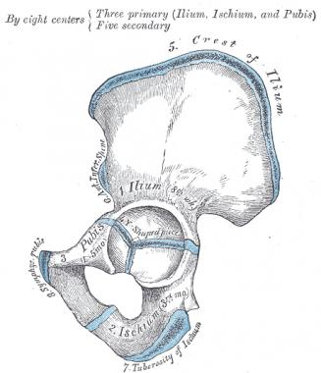

Slide 27
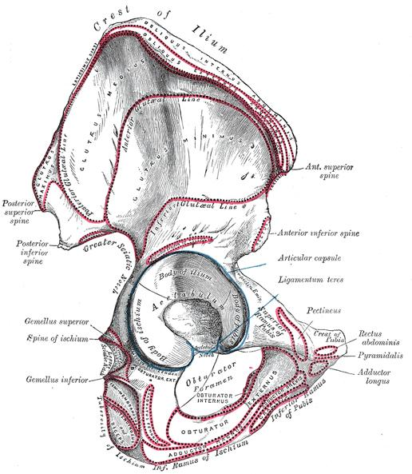

Slide 28
In infants and children, these large parts of the hip bones are incompletely ossified.
At puberty, the 3 primary bones are still separated by a Y-shaped triradiate cartilage centered in the acetabulum.
The primary bones begin to fuse at 15-17 years. Fusion is complete between 20-25 years of age.
The fact that these bones were originally separate is fairly undetectable in adult bones on imaging. Although the parts of the hip bone are fused in adulthood, they are still referred to by their separate origins.

Slide 29
Ilium
The ilium is the largest part of the hip bone and makes up the superior part of the acetabulum. The ala provides an insertion point for the gluteal muscles laterally and the iliacus muscle medially.
Anteriorly, the ilium has an anterior superior iliac spine (ASIS); inferior to this is an anterior inferior iliac spine. From the ASIS, anteriorly, the iliac crest comes around laterally and continues posterior to the posterior superior iliac spine (PSIS). The PSIS marks the superior point of the greater sciatic notch.
The lateral surface of the ilium has 3 rough curved lines: the posterior, anterior, and inferior gluteal lines. Medially, the ilium has an iliac fossa. Posteriorly, the medial aspect of the ilium has an auricular surface.

Slide 30
Ischium
The ischium is the inferior aspect of the pelvis. The superior part of the body of the ischium fuses with the pubis and ilium, forming the posteroinferior aspect of the acetabulum.
The ramus of the ischium joins the inferior ramus of the pubis to form a bar of bone called the ischiopubic ramus, which constitutes the inferomedial boundary of the obturator foramen. The posterior border of the ischium forms the lower margin of a deep indentation the greater sciatic notch. The large triangular ischial spine at the inferior margin of this notch is a sharp demarcation separating the greater sciatic notch from a smaller rounded inferior indentation called the lesser sciatic notch.
The bony projection at the inferior end of the body of the ischium and its ramus is the ischial tuberosity.

Slide 31
Pubis
The pubis makes up the anteromedial part of the hip bone and contributes the anterior part of the acetabulum. The pubis has a flat body and 2 rami: superior and inferior.
Medially, the symphyseal surface of the body of the pubis articulates at the pubic symphysis with the surface of the body of the contralateral pubis. The anterosuperior border of the united bodies and symphysis forms the pubic crest. The pubic tubercles, small projections at the lateral ends of this crest where the inguinal ligaments attach medially, are extremely important landmarks of the inguinal regions. The posterosuperior aspect of the superior ramus of the pubis is called the pectin pubis.
The obturator foramen is an oval opening formed by the rami of the pubis and the ischium. The obturator canal houses the obturator nerve and vessels.

Slide 32
Acetabulum
The acetabulum is formed from parts of the ilium, ischium, and pubis. The acetabulum is the cup-shaped socket on the lateral aspect of the pelvis, which articulates with the head of the femur to form the hip joint.
The margin of the acetabulum is deficient inferiorly. An additional fibrocartilaginous margin of the acetabulum is referred to as the acetabular labrum. The labrum functions to deepen the acetabulum, thus holding the femoral head more securely. The lunate is the articular surface of the acetabulum to the femoral head. The rough depression in the floor of the acetabulum is the acetabular fossa, which is continuous with the acetabular notch.
The transverse acetabular ligament is located along the inferior aspect of the acetabulum; it prevents the femoral head from moving inferiorly by deepening the acetabulum inferiorly.

Slide 33
Ligaments
The hip joint contains a strong fibrous capsule that attaches proximally to the acetabulum and transverse acetabular ligament and distally to the neck of the femur anteriorly at the greater trochanter
Posteriorly, the fibrous capsule crosses to the neck 1-1.5 cm proximal to the intertrochanteric crest.

Slide 34
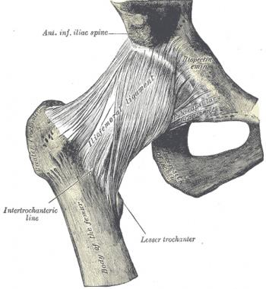

Slide 35
Most of the fibers go from the hip bone to the intertrochanteric line, but some deeper fibers go around the neck, forming the orbicular zone, which holds the femoral neck in the acetabulum. The anterior capsule of the hip is the strongest and thickest part.
This capsule is composed of 3 ligaments. The iliofemoral ligament, sometimes referred to as the Y ligament of Bigelow, attaches to the anterior inferior iliac spine and the acetabular rim proximally and takes an inferolateral direction to insert on the intertrochanteric line distally. It is the strongest part of the capsule.
The iliofemoral ligament prevents hyperextension of the hip joint during standing by holding the femoral head within the acetabulum.

Slide 36
The ischiofemoral ligament reinforces the capsule posteriorly. It originates on the ischial part of the acetabular rim and spirals superolaterally to the neck of the femur, medial to the greater trochanter.
This ligament, like the iliofemoral, also prevents hyperextension and holds the femoral head within the acetabulum.
The pubofemoral ligament reinforces the capsule anteriorly and inferiorly. It begins from the obturator crest of the pubic bone and passes inferolaterally to join the fibrous capsule of the hip joint. This ligament prevents overabduction of the hip joint.

Slide 37
An iliopectineal bursa lies anteriorly over the gap in the ligaments, beneath the iliopsoas tendon.
There are several additional structures of importance related to the fibrous capsule.
Lining the fibrous capsule is the synovial membrane. It covers the neck of the femur between the attachment of the fibrous capsule and the edge of the articular cartilage of the head; it also covers the nonarticular area of the acetabulum, providing a covering for the ligament of the femoral head.

Slide 38
Retinacula, which contain blood vessels, are deep longitudinal fibers of the capsule that go superiorly from the femoral neck and blend with the periosteum. The bursa is considered the synovial extension beyond the free margin of the fibrous capsule onto the posterior aspect of the femoral neck.
The ligament of the femoral head is weak. It attaches to the margins of the acetabular notch and the transverse acetabular ligament; its narrow end attaches to the pit in the head of the femur. Usually the ligament contains a small artery to the head of the femur.
A fat pad in the acetabular fossa is covered with synovial membrane. It fills the acetabular area that is not filled by the femoral head.

Slide 39
NERVE SUPPLY
Nerve | Root level | Sensory | Motor
Genitofemoral | L1-2 | Proximal anteromedial thigh | None in hip and thigh
Obturator | L2-4 | Inferomedial thigh | Gracilis (anterior division) Adductor longus (anterior division) Adductor brevis (anterior/posterior division) Adductor magnus (posterior division)

Slide 40
Lateral femoral cutaneous | L2-3 | Lateral thigh | None
Femoral | L2-4 | Anteromedial thigh | Psoas major Sartorius Articularis genus Rectus femoris Vastus lateralis Vastus intermedius Vastus medialis

Slide 41
Tibial | L4-S3 | None in thigh | Biceps femoris (long head) Semitendinosus Semimembranosus
Common fibular (peroneal) | L4-S2 | None in thigh | Biceps femoris (short head)
Posterior femoral cutaneous nerve | S1-3 | Posterior thigh | None

Slide 42
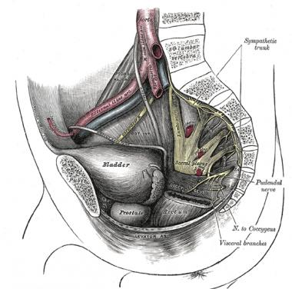

Slide 43
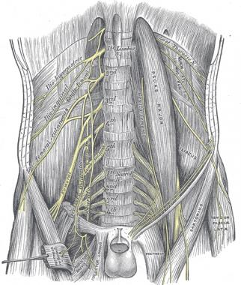

Slide 44
Muscle | Action | Nerve
Sartorius | Hip flexion, external rotation | Femoral nerve
Iliopsoas | Hip flexion | Femoral nerve
Pectineus | Hip flexion | Femoral nerve
Rectus femoris | Hip flexion, leg extension | Femoral nerve
Adductor magnus (anterior part) | Hip flexion, adduction | Obturator

Slide 45
Adductor magnus (posterior part) | Thigh extension | Tibial
Gracilis | Hip flexion, adduction, internal rotation | Obturator
Tensor fascia lata | Hip flexion, abduction | Superior gluteal nerve
Adductor brevis | Hip adduction | Obturator nerve (posterior division)
Adductor longus | Hip adduction | Obturator nerve (anterior division)
Pectineus | Hip adduction, flexion | Femoral
Obturator externus | Thigh external rotation | Obturator nerve posterior division
Gluteus maximus | Lateral rotation, extension | Inferior gluteal nerve
Piriformis | Lateral rotation | Nerve to piriformis
Obturator internus | Lateral rotation | Nerve to obturator internus
Gemellus superior | Lateral rotation | Nerve to obturator internus
Gemellus inferior | Lateral rotation | Nerve to quadratus femoris
Quadratus femoris | Lateral rotation | Nerve to quadratus femoris

Slide 46
Gluteus medius | Hip abduction | Superior gluteal nerve
Gluteus minimus | Hip abduction | Superior gluteal nerve
Semimembranosus | Thigh extension, leg flexion | Tibial
Semitendinosus | Thigh extension, leg flexion | Tibial
Biceps femoris, long head | Thigh extension, leg flexion | Tibial

Slide 47
Biceps femoris, short head | Thigh extension, leg flexion | Common fibular

Slide 48
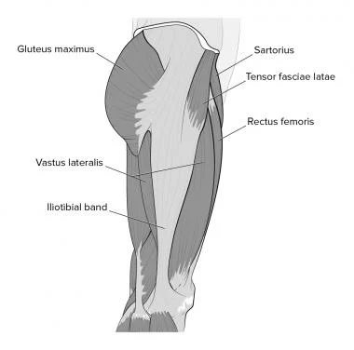

Slide 49
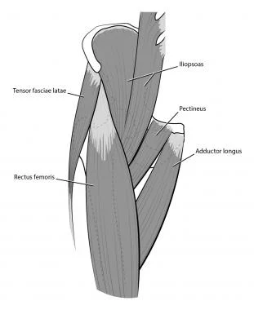

Slide 50
Artery | Branches
Obturator | Anterior and posterior branches
Femoral | In femoral triangle, runs in medial thigh between vastus medialis and adductor longus, in adductor canal, through adductor hiatus, then becomes popliteal artery behind knee Superficial circumflex iliac Superficial epigastric Superficial external pudendal Deep external pudendal Deep femoral artery Descending genicular artery Articular branch Saphenous branch

Slide 51
Deep femoral artery | Medial circumflex femoral: major supply to femoral neck Lateral circumflex femoral: also supplies femoral neck Ascending branch Transverse branch Descending branch Perforators/muscular branches

Slide 52
Artery | Course
Obturator Artery of ligament teres | Runs through ligament of femoral head
Deep femoral artery Medial circumflex femoral Ascending branch Descending branch Lateral circumflex femoral Ascending branch Cervical branches Retinacular arteries Transverse branch Descending branch | Branches from femoral artery in femoral triangle Between pectineus and iliopsoas to posterior femoral neck Runs on quadratus femoris deep to sartorius and rectus femoris to greater trochanter anteriorly Extracapsular branches of anastomosis Intracapsular branches: run along neck, enter bone at base of femoral head Extends laterally Under rectus femoris

Slide 53
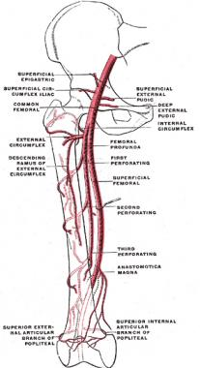

Slide 54
THE KNEE
The knee is composed of 4 bones:
the femur, tibia, fibula and patella.
All these bones are functional in the knee joint, except for the fibula.

Slide 55
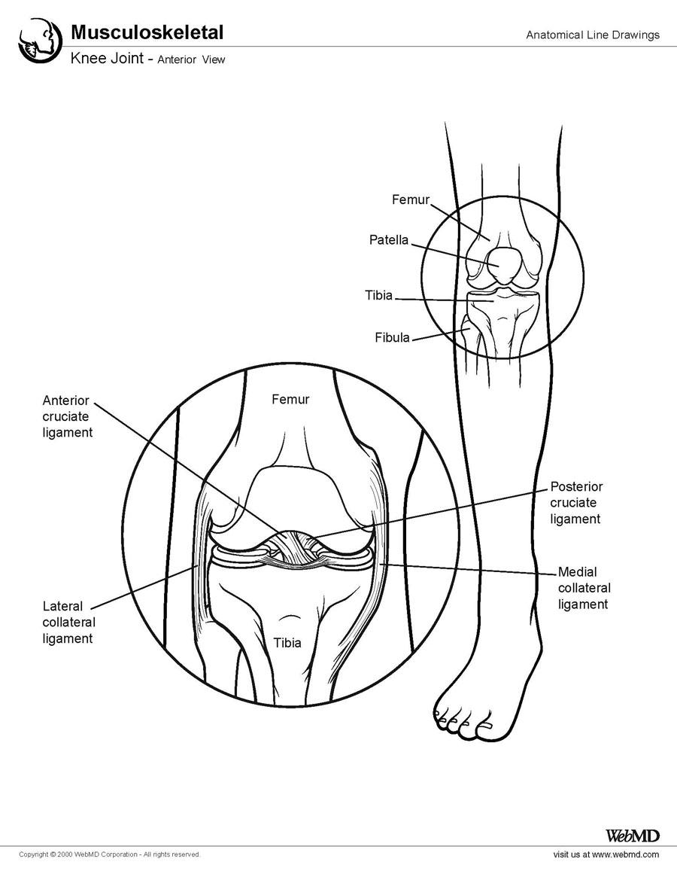

Slide 56
The femur is the longest and strongest bone in the human body. The proximal end forms the head of the femur, which projects anterosuperomedially to articulate with the acetabulum.
The distal end is wider and forms a double condyle that articulates with the tibia and patella.
The tibia articulates with the distal lateral and medial femoral condyles.
The patella articulates anteriorly to the femoral condyles in the region of the intercondylar fossa (trochlear groove).

Slide 57
The tibia lies distal to the femur and medial to the fibula. The proximal end consists of medial and lateral condyles, an intercondylar area, and the tibial tuberosity that articulates with the medial and lateral condyles of the femur.
Distally, the tibia articulates with the ankle. The distal and proximal ends of the tibia articulate with the fibula. In addition, the shaft of the tibia and fibula are connected with an interosseous membrane to form a syndesmosis joint.
The fibula does not articulate with the femur or patella. Furthermore, the fibula is not directly involved in weight transmission.

Slide 58
PATELLA
The patella is the largest sesamoid bone in the human body.
This bone is flat, proximally curved, and distally tapered; however, the shape can vary.
The posterior patella articulates with the femur, but the apex sits proximal to the line of the knee joint. The tendon of the quadriceps femoris completely encompasses the patella.

Slide 59
Cartilaginous Menisci
The paired menisci are crescentic, fibrocartilaginous pads that attach to the intercondylar area and periphery of the tibial plateau. This cartilage serves to widen and deepen the articulating surface between the femoral condyles and the tibia. To deepen the surface, the peripheral borders are thick and convex, and the inner borders are thin and concave.
The outer region is well-vascularized from capillaries branching off the fibrous capsule and synovial membrane. The inner regions, however, are avascular. Therefore, tears of the peripheral meniscus typically heal well, whereas tears of the inner meniscus do not. A discoid lateral meniscus occurs in up to 5% of the population. The lateral meniscus is generally wider and gets caught between the femur and tibia, which can cause "clunking" in some patients.

Slide 60
Ligaments
The ligaments of the knee joint can be divided into the extracapsular ligaments and intra-articular ligaments.
The extracapsular ligaments or external ligaments are the patellar ligament, medial collateral ligament (MCL), lateral collateral ligament (LCLs), oblique popliteal ligament, and arcuate popliteal ligament.
The intra-articular ligaments are the anterior cruciate ligament (ACL), posterior cruciate ligament (PCL), and the posterior meniscofemoral ligament.

Slide 61
The patellar ligament is the anterior ligament of the knee joint.
It is the distal part of the quadriceps tendon and attaches to the tibial tuberosity.
The vastus medialis and lateralis contribute to the patellar ligament medially and laterally through the medial and lateral retinacula, which make up the joint capsule of the knee on either side of the patella. The retinacula also maintain alignment of the patella relative to the patellar surface of the femur.

Slide 62
The LCL extends from the lateral epicondyle of the femur to the lateral surface of the fibular head.
The LCL is separated from the lateral meniscus by the popliteus tendon.
The LCL also splits the tendon of the biceps femoris into 2 parts.

Slide 63
The MCL extends from the medial epicondyle of the femur to the medial condyle and superior part of the medial surface of the tibia.
The MCL is firmly attached to the medial meniscus, which is why these are commonly torn at the same time in contact sports.
The oblique popliteal ligament and arcuate popliteal ligament reinforce the joint capsule on the posterior aspect. The oblique popliteal ligament is a recurrent expansion of the tendon of the semimembranosus, and it arises from the medial tibial condyle and passes toward the lateral femoral condyle, where it blends in with the rest of the joint capsule.
The arcuate popliteal ligament arises from the posterior fibular head and passes over the tendon of the popliteus and spreads over the posterior surface of the knee.

Slide 64
The ACL attaches posterior to the attachment of the medical meniscus on the anterior intercondylar area of the tibia and passes superior, posterior, and lateral, where it attaches to the posterior part of the medial side of the lateral condyle of the femur.
The PCL arises from the posterior intercondylar area and passes on the medial side of the ACL to attach to the anterior part of the lateral surface of the medial condyle of the femur.
The menisci are wedge shaped and attach at their ends to the intercondylar area of the tibia. The medial meniscus is C shaped and firmly adheres to the deep surface of the MCL medially, the ACL anteriorly, and the PCL posteriorly. Because of these attachments, the medial meniscus is less mobile than the lateral meniscus.

Slide 65
Cutaneous Nerves
Branches of the obturator, femoral, tibial, and common fibular nerves contribute to innervation of the knee joint.
The infrapatellar branch of the saphenous nerve provides cutaneous sensation to the medial anterior aspect of the knee.
The peripatellar plexus is composed of branches from anterior cutaneous branches of the femoral nerve and the lateral femoral cutaneous nerve to provide cutaneous sensation to the rest of the knee.

Slide 66
Muscles and Tendons
The main motion of the knee joint is flexion and extension, with limited medial and lateral rotation. The main muscle for extension is the quadriceps femoris, which is the most important muscle in stabilizing the knee joint. The quadriceps is made up of the vastus medialis and lateralis, rectus femoris, and vastus intermedius. The tensor fasciae latae is a weak extensor.
Flexion is produced by the hamstring muscles, which consist of the semitendinosus, semimembranosus, and long head of the biceps femoris along with the short head of the biceps and, weakly, the gracilis, sartorius, gastrocnemius, and popliteus.
The medial rotators of the knee are the semitendinosus, semimembranosus, popliteus, gracilis, and sartorius.
The lateral rotator of the knee is the biceps femoris.

Slide 67
Vascular Supply
Many vessels are involved in forming the arterial anastomosis around the knee joint. This anastomosis is formed by the superior, middle, and inferior genicular branches of the popliteal artery; the descending genicular branch of the femoral artery; and the descending branch of the lateral circumflex femoral artery, the circumflex fibular artery, and the anterior and posterior tibial recurrent arteries. The anastomosis supplies the patella, the femoral and tibial condyles, bone marrow, articular capsule, and synovial membrane.
The popliteal artery, however, is the major artery that crosses the popliteal fossa in the posterior aspect of the knee. Because of its location, this artery is susceptible to damage in knee injuries.
The venous system of the knee joint is primarily composed of the popliteal and femoral veins. These veins simply run with their corresponding arteries and drain deoxygenated blood from the arterial anastomosis. The popliteal veins contain 3-4 valves.

Slide 68
Bursae
Many bursae surround the knee and the arrangement is complex and variable.
However, the medial group, including the anserine bursa and the semimembranosus bursa, are clinically important. The anserine bursa is located 4-5 cm distal to the anteromedial joint line and deep to the pes anserinus, the conjoint tendon formed by the sartorius, gracilis, and semitendinosus tendons.
Deep to the anserine bursa is the insertion of the MCL. This bursa can become inflamed with excessive physical activity. The semimembranosus bursa is located in the popliteal fossa and commonly causes posterior swelling of the knee joint secondary to degeneration within the knee joint.

Slide 69
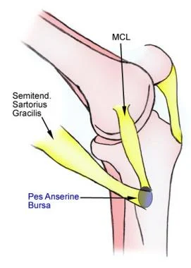

Slide 70
Joint Capsule
The joint capsule consists of the external fibrous layer and the internal synovial membrane. The fibrous layer is thin, except for the thickened parts that make up the intrinsic ligaments of the knee. On the posterior aspect, it encloses the condyles and the intercondylar fossa. Distally, it attaches to the margin of the superior articular surface of the tibia.
The synovial membrane lines all surfaces of the articular cavity not covered with articular cartilage. It attaches to the periphery of the articular cartilage, which covers the femoral and tibial condyles, posterior surface of the patella, and the popliteal surface of the femur.

Slide 71
Synovial Fluid
All freely moveable joints have some synovial fluid in them.
Synovial fluid originates from plasma that is filtered by the capillary net and diffuses into the knee along with hyaluronic acid, which is locally synthesized.
Synovial fluid transports nutrients, assists in the joint's defense, and lubricates the joint.

Slide 72
Natural Variants
In children, the appearance of bowlegged knees for the first 1-2 years of life right after the child is learning how to walk is common. "Knock knees" are commonly seen in the 2-4 – year-old age group. If these deformities persist into later childhood, the deformity may have a pathophysiologic cause.
Osgood-Schlatter is a disease that causes pain at the tibial tuberosity in young adolescents, which is exacerbated with activities and direct contact. Repetitive overload at the patellar ligament insertion can cause inflammation, irregularity, and partial avulsion of the secondary ossification center. Radiographs typically reveal irregularity and fragmentation.

Slide 73
Pathophysiologic Variants
Valgus and Varus
Genu valgum or "knock knees" is a lateral angulation of the leg in relation to the thigh, which causes excess pressure to be placed on the outside or lateral aspect of the knee joint; this, in turn, can lead to joint-space narrowing and degenerative changes.
Genu varum or bowleg is a medial angulation of the leg in relation to the thigh, which causes excess pressure to be placed on the inside or medial aspect of the knee joint; this, in turn, can cause arthritis, which is destruction of the cartilage between the femur and tibia. This leads to joint-space narrowing and places stress on the fibular collateral ligament.

